Slide 1
Course Title
Human-Computer Interaction

Slide 2
Lecturer
Ying Shen
Room: 408R, Jishi Building
Tel: 6958 9976
E-mail: yingshen@tongji.edu.cn
TA: TBA

Slide 3
Lecture Hours
1:30-3:10pm Thursday

Slide 4
References
TBA

Slide 5
Assessment
Project 50%
Assignment 40%
Participation 10%
Course Web Page
http://sse.tongji.edu.cn/~yingshen/HCI2016Spring/index.html

Slide 6
What is Human-Computer Interaction?
Human
Computer
Interface

Slide 7
Human-Computer Interaction
The study of how people design, implement and use interactive computer systems.
The study of how computers affect individuals, organizations, and society.
Notes:
1.用户界面设计，多媒体交互技术
2.计算机对人的影响，摇一摇，facebook，instagram，apple watch

Slide 8
Requirements of HCI
Ease of use
GUI vs command language
Online help, documentation and training
More powerful forms of communications between users and computers
New interaction techniques
New input and output devices
Notes:
最好不需要或者需要简单的training
春晚羊羊
data glove，google glass
kinect，全息投影

Slide 9
Requirements of HCI (cont’d)
Universal access to information
Proliferation of WWW
Information-access interfaces
Must be able to deal with new kinds of data, e.g., multimedia information.
Permit new kinds of interaction.
Require collaborations between HCI and database research communities.

Slide 10
Importance of HCI
Good HCI design is critical to
Success of products in marketplace
Safety, usefulness and pleasure of using computer-based systems.
Poor HCI design have led to several well-known catastrophes.
Notes:
三里岛事故

Slide 11
Importance of HCI (cont’d)
Good HCI design can decrease costs and increase productivity due to
Fewer errors
Reduced user disruption
Decreased task time
Reduced burden on support staff
Elimination of training

Slide 12
Foundations of HCI
Computer science
Psychology
Sociology/anthropology
Linguistics
Artificial intelligence
Notes:
Linguistics：网络语言

Slide 13
History of HCI
Direct manipulation of graphical objects.
Windows
Hypertext
Notes:
https://www.sensomatic.com/chz/gui/history.html

Slide 14
Direct manipulation of graphical objects
First demonstrated by Ivan Sutherland in Sketchpad
Use light pen to manipulate objects.
Most of the direct manipulation techniques are developed in Xerox PARC in 1970’s.
“Direct Manipulation” was first coined by Ben Shneiderman (University of Maryland).

Slide 15
Windows
Tiled windows
First demonstrated by Engelbart.
Other systems: COPILOT, Emacs.
Overlapping windows
First proposed by Alan Kay
Used in the Smalltalk system (Xerox PARC)

Slide 16
Hypertext
Original idea is credited to Vannevar Bush
The term “hypertext” is first coined by Ted Nelson.
Ben Shneiderman’s Hyperties
First system where highlighted items in the text could be selected to go to other pages.

Slide 17
Hypertext (cont’d)
Apple Hypercard further popularizes the idea to a wide audience.
Tim Berners-Lee’s adoption of hypertext in browser leads to spectacular growth of the World Wide Web.

Slide 18
HCI Applications
Multimedia information retrieval.
Education
Interface for security enforcement
Information visualization
Computer-mediated communication

Slide 19
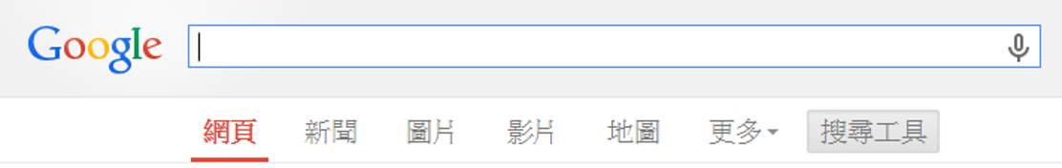
Multimedia Information Retrieval
In many cases, multimedia contents cannot be easily characterized by specific keywords.
Interfaces equipped with alternative querying mechanisms, such as example-based query specification, are required for effective retrieval.

Slide 20
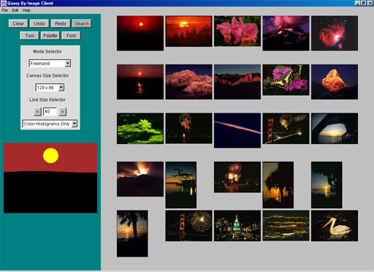
Multimedia Search Engine

Slide 21
Education
Adoption of direct manipulation techniques in interface design.
Design of effective learning environments, tools and media for distance learning.
Catering for different student communities
Primary/secondary school students
University students
Further education
On-the-job training

Slide 22
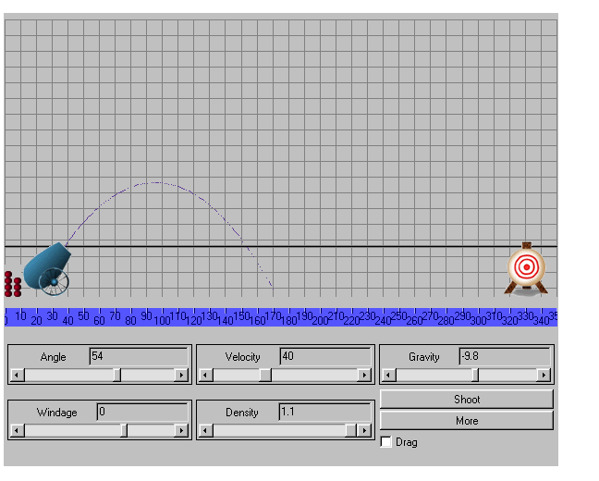
Direct Manipulation Examples (cont’d)
Physics

Slide 23
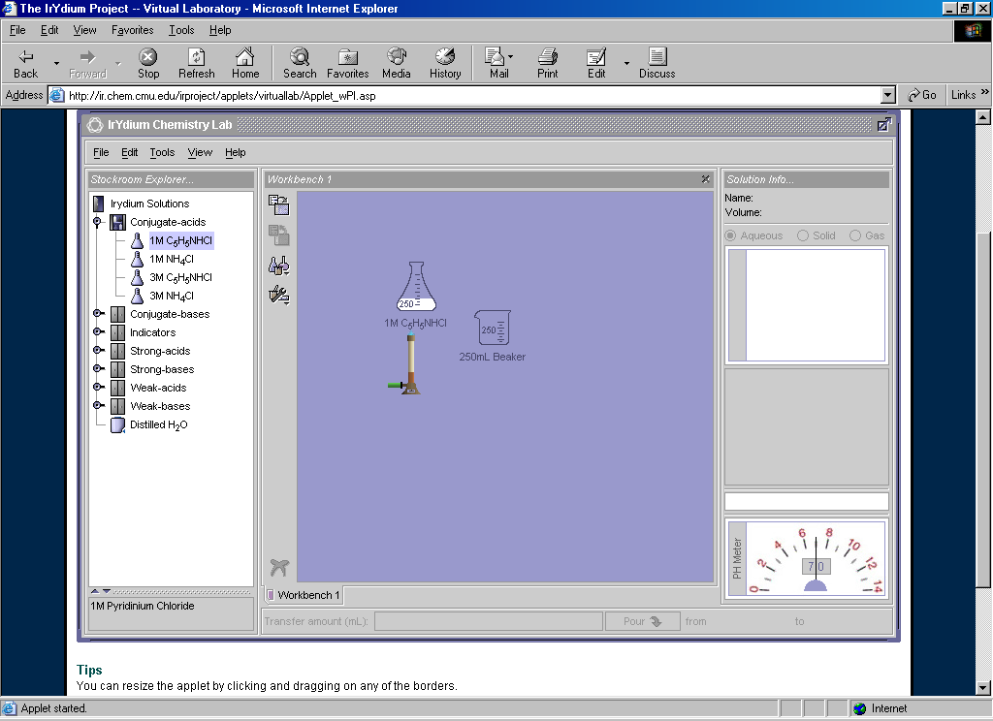
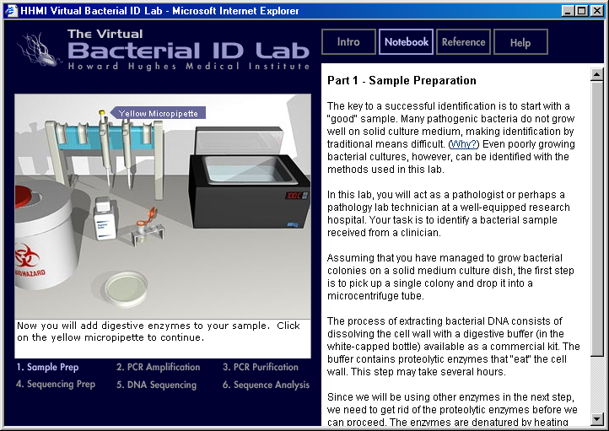
Direct Manipulation Examples (cont’d)
Chemistry
Biology

Slide 24
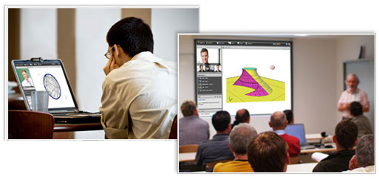
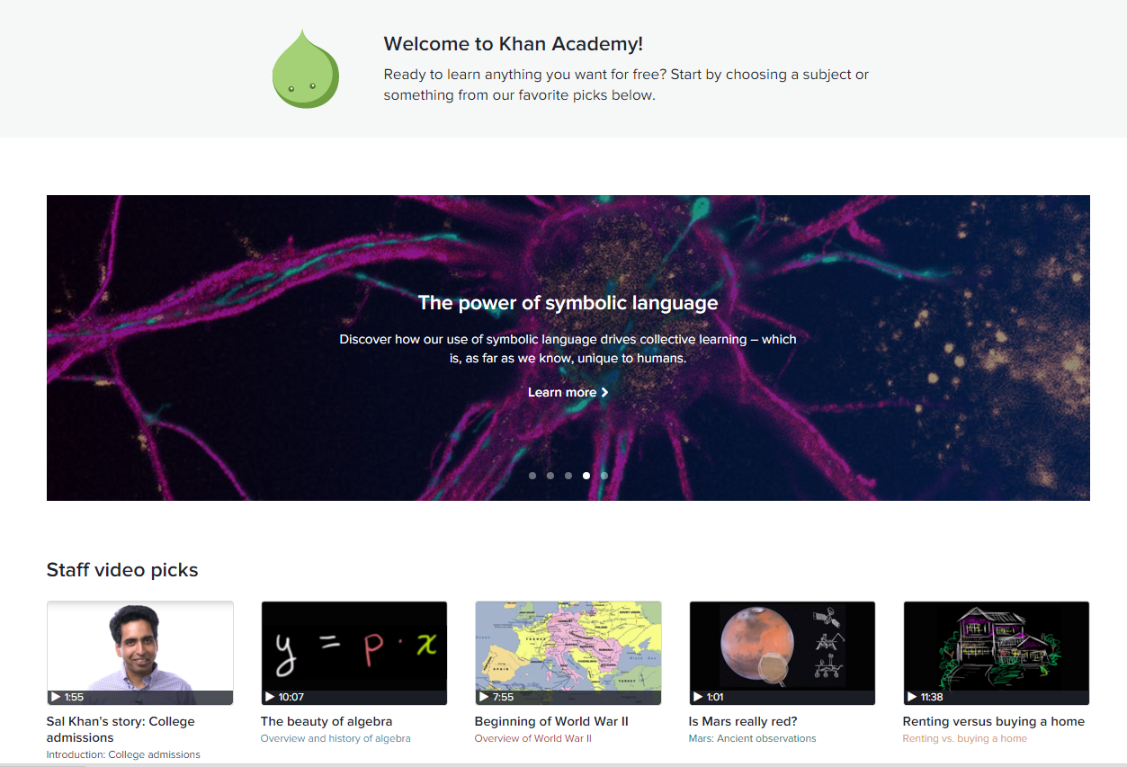
Distance Learning

Slide 25
Interface for Security Enforcement
User authentication based on a set of biometric features:
Fingerprints
Iris
Speech patterns
Facial characteristics
Non-intrusive techniques are preferable to intrusive techniques.

Slide 26
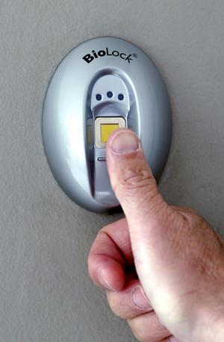
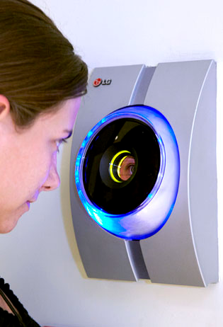
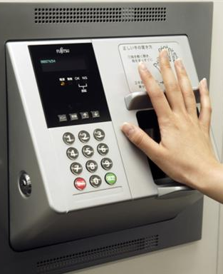
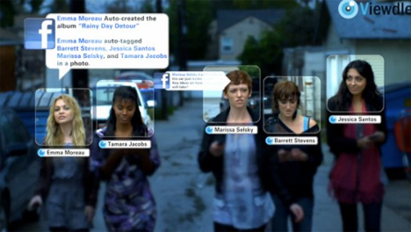
Interface for Security Enforcement

Slide 27
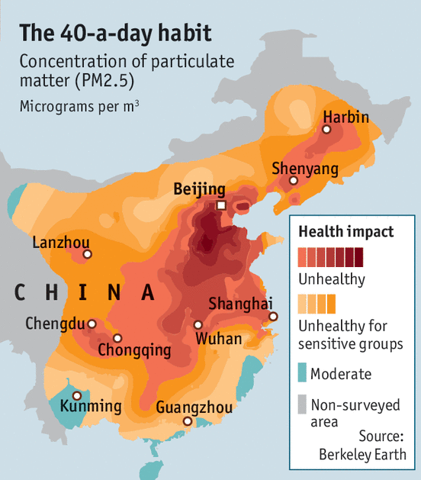
Information Visualization
Presentation of large data sets in a suitable graphical formats for trend exploration.
Becomes more important due to information explosion brought on by the Web.
Examples
Visualizing communication networks.
Example
Visualizing the Web itself
Example
Notes:
大数据电影票房预测

Slide 28
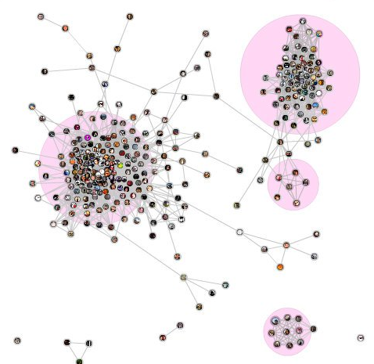
Visualizing Communication Networks
Notes:
Here's a visualization of the connections between my Facebook friends, which I created with the “social graph” Facebook application.

Slide 29
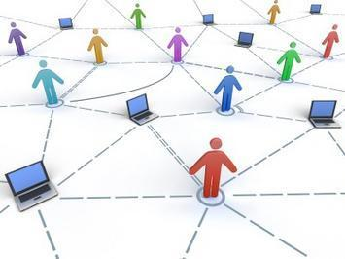
Computer-mediated Communication
Communication between human users through computers.
Examples include
E-mail
Real-time video and audio interactions
Notes:
qq, skype, gtalk

Slide 30
Technological Trends
Computational devices and ubiquitous computing.
Recognition-based user interfaces.
Conversational interface and animated agents
3-D Technologies.

Slide 31
Computational Devices and Ubiquitous Computing
New types of computational devices in addition to workstations and PC
Laptops
Mobile phones
Personal Digital Assistant (PDA)
Wearable computers and devices.
Ubiquitous computing
Embedding computers everywhere in our environment.
Example: MIT’s Things That Think (TTT) project
Notes:
pda: mobile device that functions as a personal information manager.
PDAs were discontinued in early 2010s after the widespread adoption of smartphones
ubiquitous computing can occur using any device, in any location, and in any format.

Slide 32
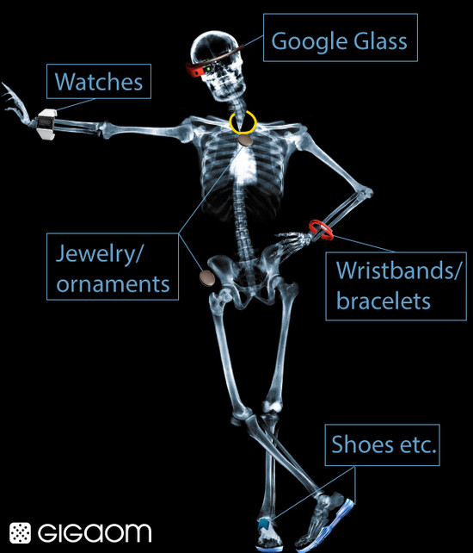
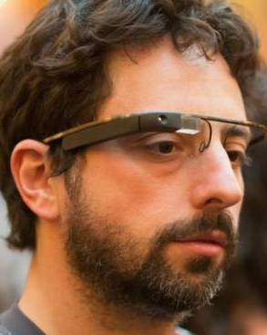
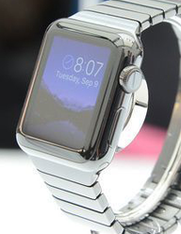
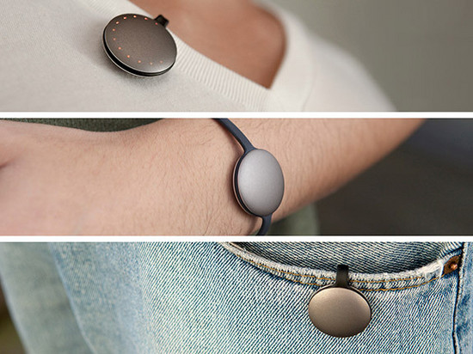
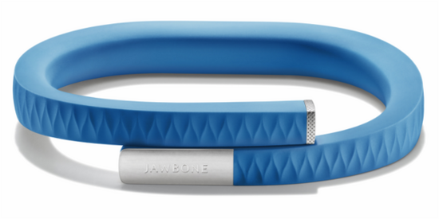
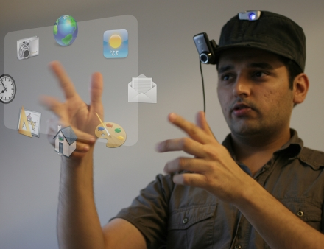
Wearable Computers
Notes:
https://www.media.mit.edu/wearables/mithril/photos.html
MIThril is a next-generation wearables research platform developed by researchers at the MIT Media Lab. The goal of the MIThril project is the development and prototyping of new techniques of human-computer interaction for body-worn applications. Through the application of human factors, machine learning, hardware engineering, and software engineering, the MIThril team is constructing a new kind of computing environment and developing prototype applications for health, communications, and just-in-time information delivery.
The SixthSense technology contains a pocket projector, a mirror and a camera contained in a head-mounted, handheld or pendant-like, wearable device. Both the projector and the camera are connected to a mobile computing device in the user’s pocket. The projector projects visual information enabling surfaces, walls and physical objects around us to be used as interfaces; while the camera recognizes and tracks users' hand gestures and physical objects using computer-vision based techniques. The software program processes the video stream data captured by the camera and tracks the locations of the colored markers (visual tracking fiducials) at the tips of the user’s fingers. The movements and arrangements of these fiducials are interpreted into gestures that act as interaction instructions for the projected application interfaces. SixthSense supports multi-touch and multi-user interaction.
Conflicting requirements
Tailoring interfaces appropriate to the device.
Offering a familiar interface so that users can quickly adapt to the new device.
http://www.tuicool.com/articles/AR7BBf

Slide 33
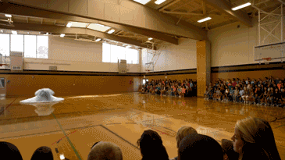
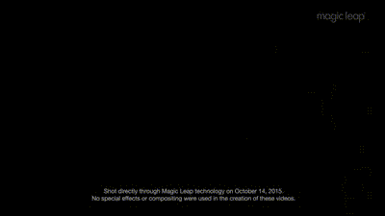
Wearable Computers
Magic leap
Notes:
http://v.ifeng.com/vblog/others/201510/044e6d9a-18c3-4b0c-9a69-3cd064422141.shtml
http://www.kankanews.com/a/2015-10-29/0017189449.shtml

Slide 34
Recognition-based User Interfaces
Current user interface mainly uses keyboard and mouse for input.
Recognition-based user interface will become more and more important
Speech input and output
Handwriting
Gestures

Slide 35
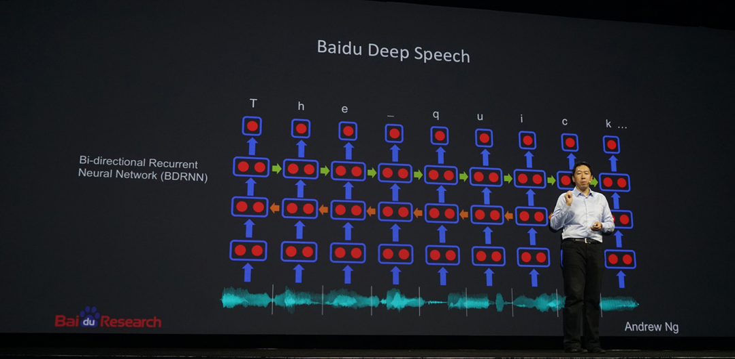
Example: Speech Recognition
Notes:
The PC sound card converts analog waves spoken into the micrcophone into a digital format. The software acoustic model breaks the word into three phonemes: ST UH FF. The software language model compares the phonemes to words in its built-in dictionary. The software decides what it thinks the spoken word was and display the best match on the screen.
http://www1.icsi.berkeley.edu/Speech/faq/SRapproaches.html
application: 语音拨号（voice dialing）speech-to-text processing (e.g., word processors or emails)

Slide 36
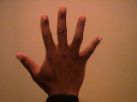

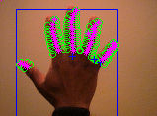
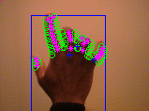
Example: Gesture Recognition
Notes:
https://www.youtube.com/watch?v=Rmh-mZFxWns
https://www.youtube.com/watch?v=sEGY6MyPqsY

Slide 37
Recognition-based User Interface
Fundamental differences from today’s interfaces
Sophisticated pattern recognition techniques are involved in the interface design.
Interface with feedback facilities are required due to recognition error.

Slide 38
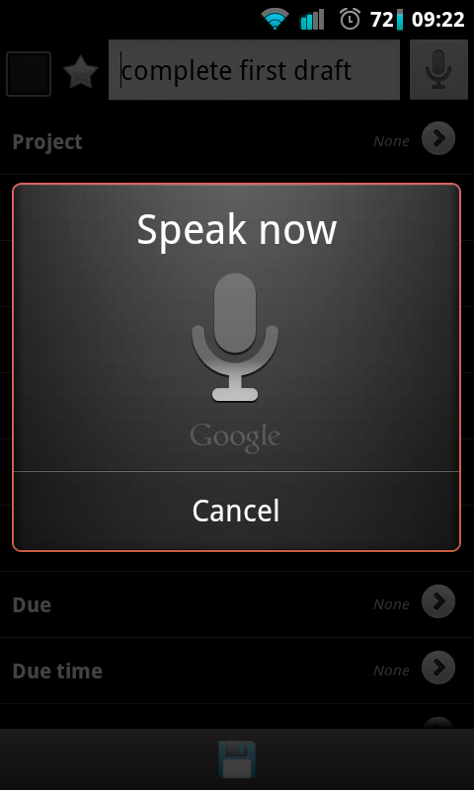
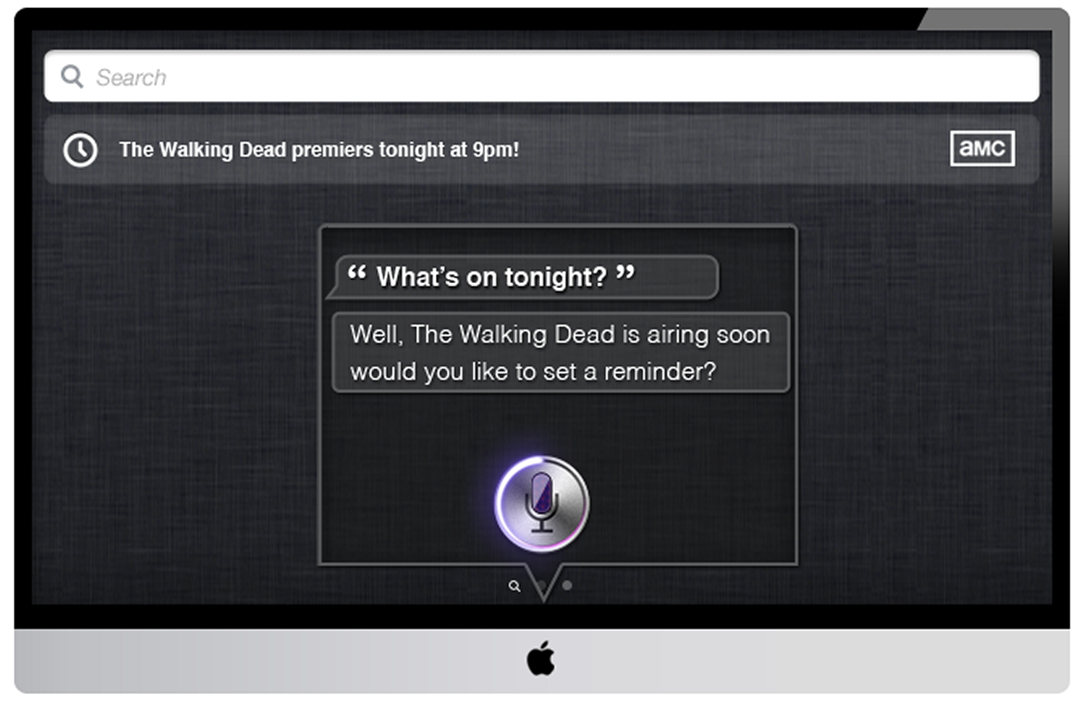
Conversational Interface
Interfaces which can respond intelligently to human conversations.
The most famous example is the computer program ELIZA.
An example of a conversational interface.

Slide 39
ELIZA: An Example Conversation
He says I'm depressed much of the time.
I AM SORRY TO HEAR YOU ARE DEPRESSED
It's true. I am unhappy
DO YOU THINK COMING HERE WILL HELP YOU NOT TO BE UNHAPPY
I need some help, that much seems certain.
WHAT WOULD IT MEAN TO YOU IF YOU GOT SOME HELP
Perhaps I could learn to get along with my mother.
TELL ME MORE ABOUT YOUR FAMILY
My mother takes care of me.
WHO ELSE IN YOUR FAMILY TAKES CARE OF YOU
My father.

Slide 40
ELIZA
The input is inspected for the presence of a keyword.
When such a word is found
The sentence is transformed according to a rule associated with the keyword.
The text is then displayed.
Keywords may have a rank or precedence number.

Slide 41
ELIZA
A kind of template is applied to transform the original sentence.
Example:
“I am very happy these days”
“How long have you been very happy these days?”
Templates:
“I am X”
“How long have you been X ?”

Slide 42
ELIZA
Another example
“It seems that you hate me”
“What makes you think I hate you ?”
(1)
(2)
(3)
(4)
“It seems that | you| hate |me”

Slide 43
ELIZA
Search for the pattern
“(1) you (3) me”
Reassembly rule
Throw away component (1).
Apply the following rules:
you→I
me→you
Tack on a relevant phrase to the front.

Slide 44
ELIZA
Formal notation
“(1) you (3) me”
“What makes you think I (3) you”

Slide 45
Complete System
Speech recognition
Conversion of sound waves to discrete words.
Natural language understanding
Understand the meaning of the words.
Natural language generation
Generate appropriate responses.
Speech synthesis
Generation of natural-sounding speech.

Slide 46
Animated Agents
Combine spoken dialogue with human-like animated characters.
The characters can augment speech with body language, facial expression and gaze.
Requires computer graphics and animation techniques.

Slide 47
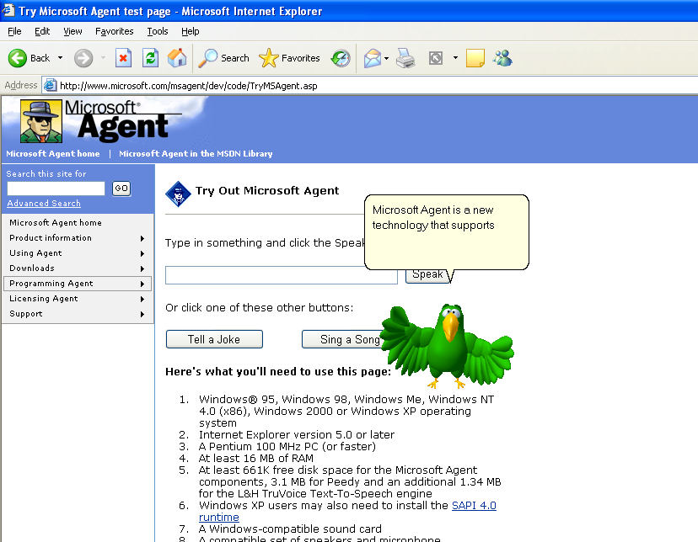
Animated Agents
Notes:
win7以后的版本里被淘汰
office里的Clipit（大眼回形针）

Slide 48
3-D Technologies
Migration from 2-D presentation space to 3-D space.
Applications areas that benefit from 3-D technologies
Training
Simulation
Interactive exploration of complex data environments.

Slide 49
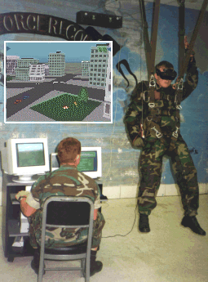
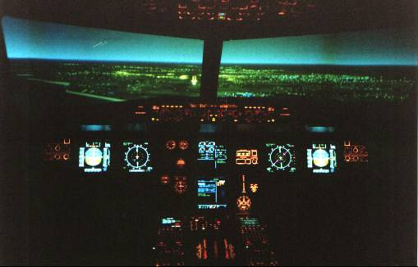
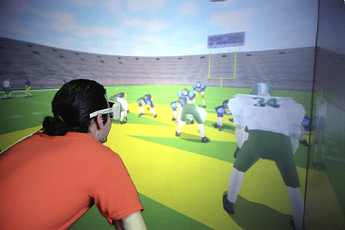
Examples
Football Training
Flight Simulator
Parachute Training
Notes:
最常见的例子就是3D图形游戏

Slide 50
3-D Technologies (cont’d)
Previous 2-D notions need to be revised
How to interact with information ?
How to select objects in 3-D space ?
How to navigate through information spaces ?
Objective: “near-real-time” interactivity to achieve the effect of direct manipulation

Slide 51
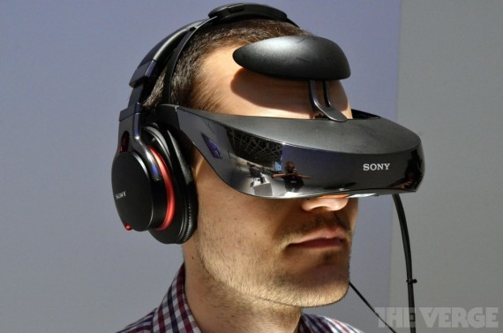
Head-Mounted Display
Notes:
Military, police and firefighters use HMDs to display tactical information such as maps or thermal imaging data while viewing the real scene.

Slide 52
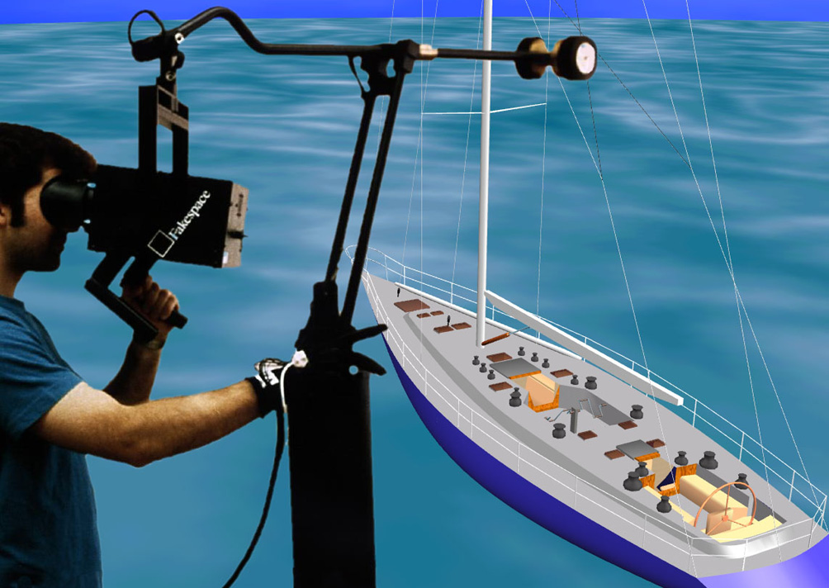
Binocular Omni-Orientation Monitor (BOOM)
Notes:
Binocular：双目
Omni-Orientation ：全方位
The Binocular Omni Orientation Monitor or BOOM is one of the oldest VR displays, and direct ancestor to the HMD.

Slide 53
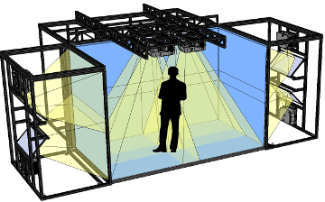
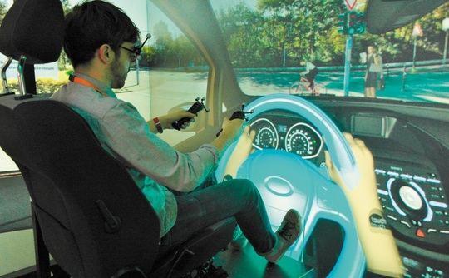
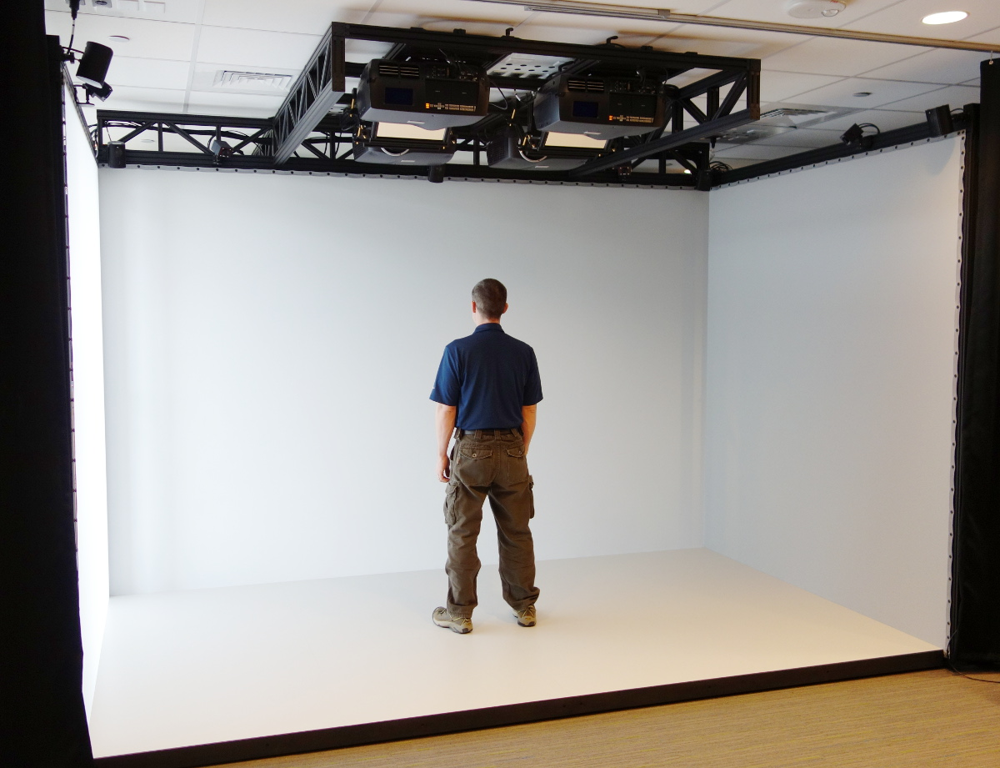
Cave Automatic Virtual Environment (CAVE)
Notes:
developed at U of Illinois, Chicago
projects stereo images onto walls and floor of a room-sized cube
users wear lightweight stereo glasses & can move freely
several users can be in same room
headtracker adjusts display to "lead user"
Ford shows off its 3D Cave automatic virtual environment
http://www.theinquirer.net/inquirer/feature/2268800/ford-shows-off-its-3d-cave-automatic-virtual-environment

Slide 54
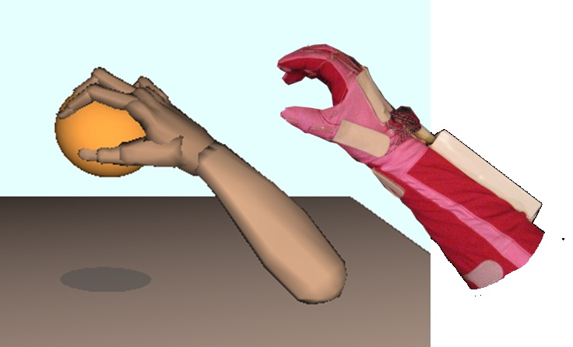
Data Glove
Notes:
https://www.youtube.com/watch?v=-b9UNLNkYFY
https://www.youtube.com/watch?v=PIhmBszYHOU
game glove: https://www.youtube.com/watch?v=W9wWnI5pnpo
5dt data glove 5 ultra 1w

Slide 55
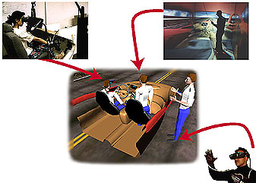
Collaborative virtual environment
Notes:
A collaborative virtual environment is a space in which several people interact with each other, often over several locations. The aim is for these people to share ideas and experiences in a co-operative setting - hence the name.
Marketing: consumer interaction
Training in dangerous/harmful situations
Social entertainment, e.g. multi-player games
Medicine: surgery simulation
Healthcare: virtual reality in phobia treatment

Slide 56
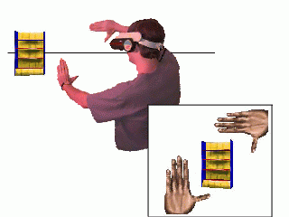
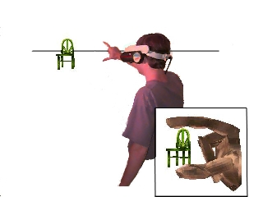
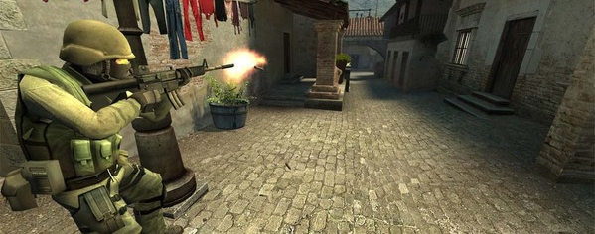
Selecting Objects in 3-D Space
Notes:
https://www.youtube.com/watch?v=chHI30_stQg

Slide 57
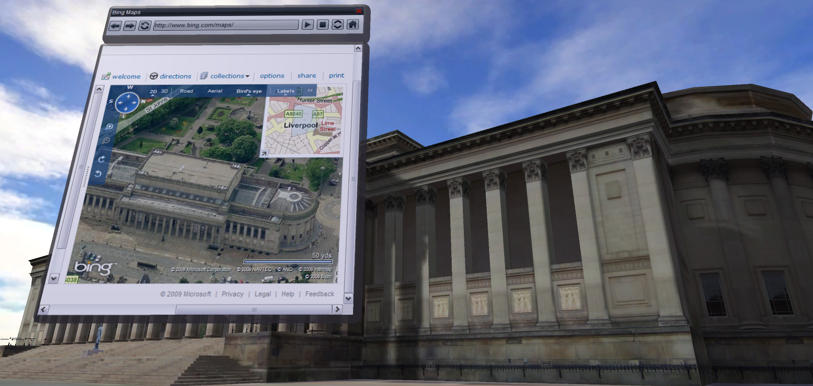
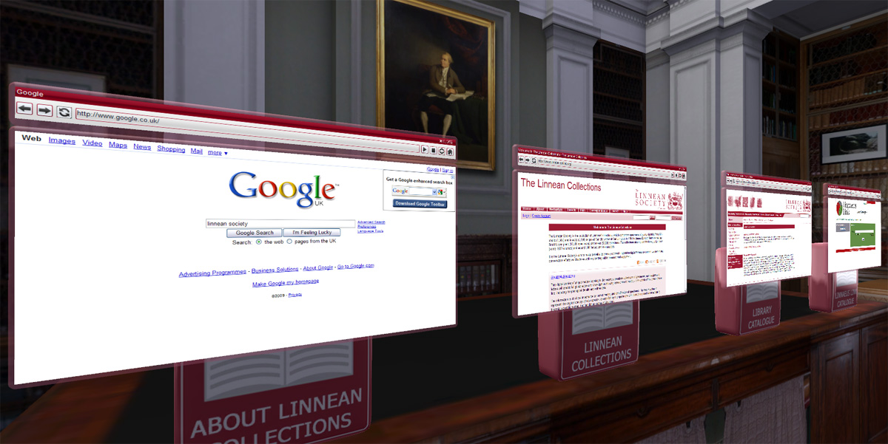
Browser in 3-D space
Notes:
https://www.youtube.com/watch?v=ni3G1r0Myj4

